Slide 1
RNA-Seq data analysis protocol
Hui Yang
2017.12.21

Slide 2
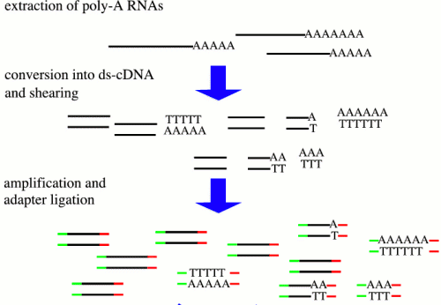
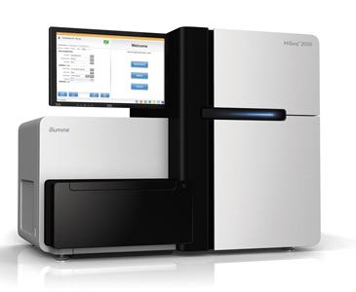


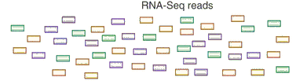
Overview of RNA-Seq
Transcriptome profiling using NGS

Slide 3
From reads to differential expression
Raw Sequence Data
FASTQ Files
QC by
FastQC
Reads Mapping
Unspliced Mapping
BWA, Bowtie
Spliced mapping
TopHat, Hisat
Mapped Reads
SAM/BAM Files
QC by
RNA-SeQC
Expression Quantification
Summarize read counts
FPKM/RPKM
Cufflinks, Stringtie
QC between
replicates
DE testing
DEseq, edgeR, etc
Cuffdiff, Ballgown
List of DE
Functional Interpretation
Function enrichment
Integrate with other data or Infer networks …
Biological Insights & hypothesis

Slide 4
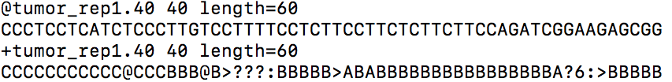
Obtain Raw Sequence Data
In house RNA-Seq from Illumina et al
Public RNA-Seq data from GEO [GSE52194]
gunzip ${sample}.fastq.gz #decompress raw file
wget ftp:xxx/SRRxxx.sra -O ${sample}.sra #download raw data from SRA
fastq-dump --split-files ${sample}.sra #convert .sra to .fastq format
#${sample}_2.fastq for paired-end
Fastq format:
Example
Line1: Sequence identifier
Line2: Raw sequence
Line3: meaningless
Line4: quality values for the sequence
Notes:
替换成public的数据

Slide 5
Raw Sequencing Data QC-FastQC
Information can be checked
Basic Statistics( total reads, sequence length, GC content etc.)
Per base sequence quality
Overrepresented sequences
GC content
Duplication level
etc.
Input command line:
fastqc data1.fastq
Output format: html webpage
http://www.bioinformatics.babraham.ac.uk/projects/fastqc/

Slide 6


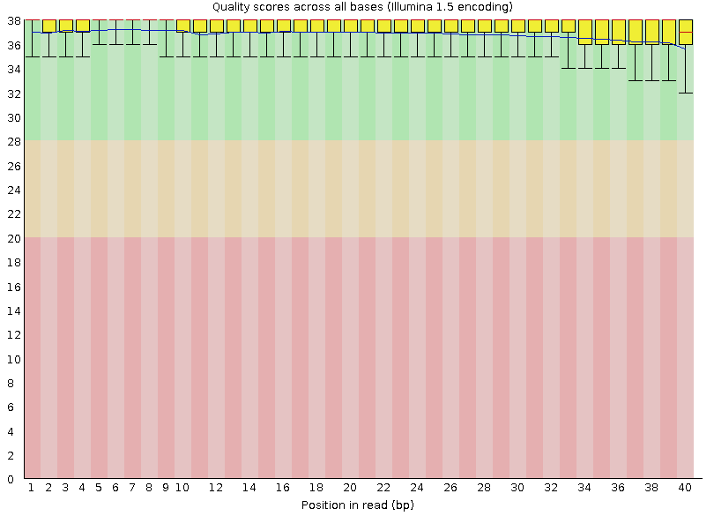
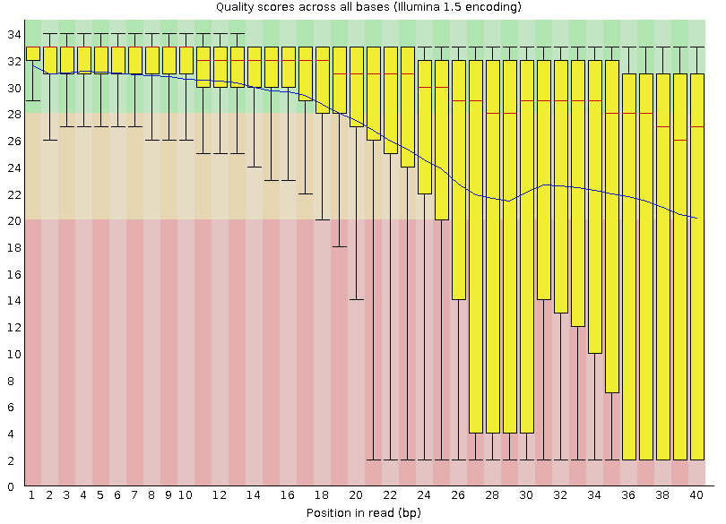
Per base sequence quality

Slide 7
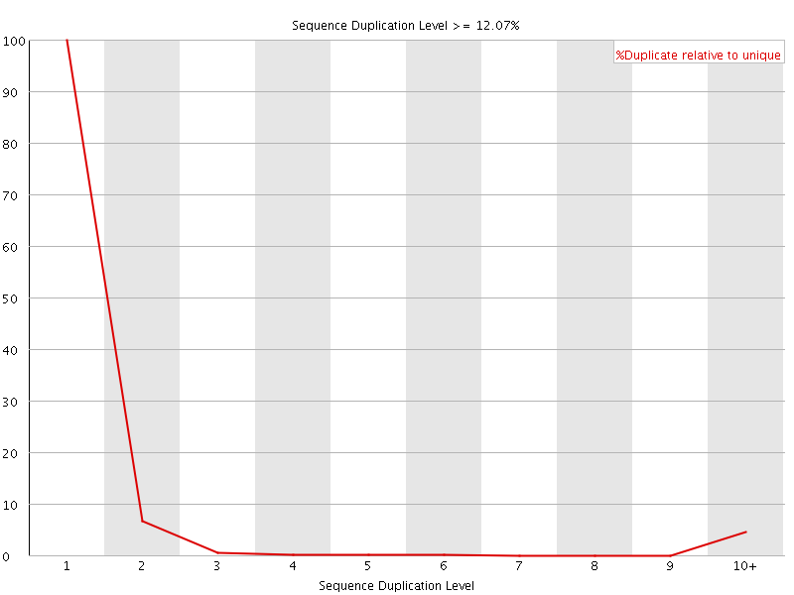
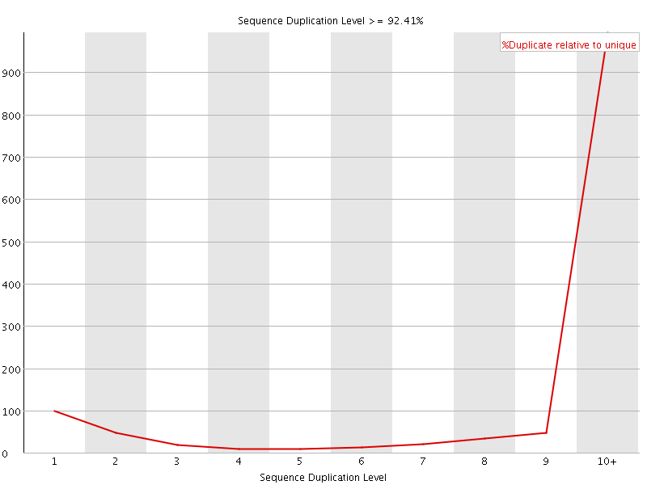
Duplication level

Slide 8
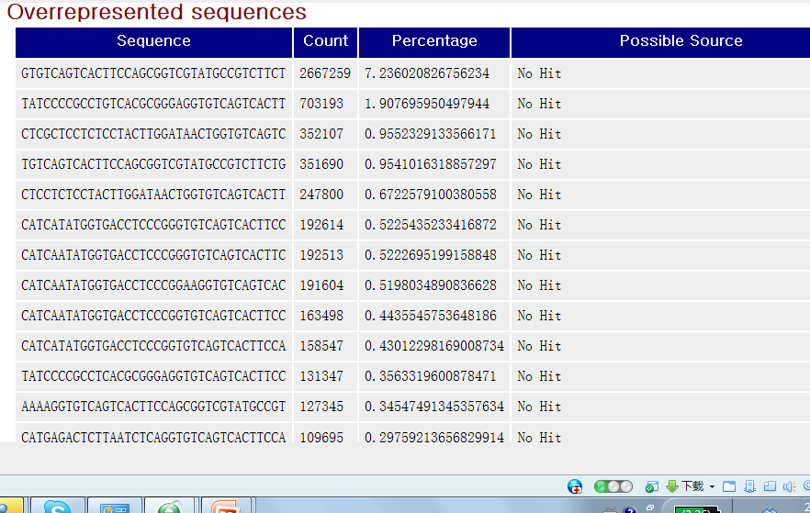
Overrepresented Sequences
Adapter

Slide 9
From reads to differential expression
Raw Sequence Data
FASTQ Files
QC by
FastQC
Reads Mapping
Unspliced Mapping
BWA, Bowtie
Spliced mapping
TopHat, Hisat
Mapped Reads
SAM/BAM Files
QC by
RNA-SeQC
Expression Quantification
Summarize read counts
FPKM/RPKM
Cufflinks, Stringtie
QC between
replicates
DE testing
DEseq, edgeR, etc
Cuffdiff, Ballgown
List of DE
Functional Interpretation
Function enrichment
Integrate with other data or Infer networks …
Biological Insights & hypothesis

Slide 10
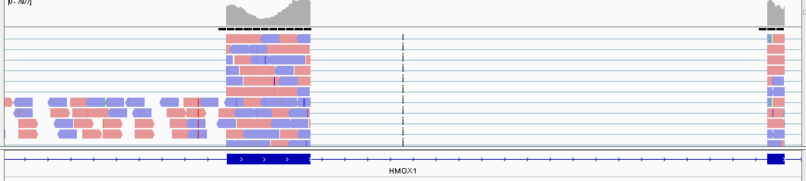
Read mapping
exon mapping
exon-exon junction
Unlike DNA-Seq, when mapping RNA-Seq reads back to reference genome, we need to pay attention to exon-exon junction reads

Slide 11
List of mapping methods
Class | Tools | Notes | Uses
Unspliced aligners | Bowtie | Index reference sequence | Aligning reads to a reference transcriptome
 | BWA | Incorporates quality scores
Spliced aligners | Tophat | Use Bowtie alignments | Aligning reads to a reference genome. Allows for the identification of novel splice junctions
 | Hisat | Use a graph FM index
 | STAR | Use sequential maximum mappable seed search
Notes:
https://bmcgenomics.biomedcentral.com/articles/10.1186/1471-2164-15-570

Slide 12
Usual mapping methods-tophat2
Command line usage:
tophat2 [options]* <genome_index_base> <reads1_1[,...,readsN_1]> [reads1_2,...readsN_2]
Typical Parameter:
<genome_index_base> The basename of the genome
<reads1_1[,...,readsN_1]> Reads files, *_1 format when paired-end
[reads1_2,…readsN_2] Only used when paired-end, the order
must be the same as *_1 files.
-r/--mate-inner-dist <int> Expected inner distance between mate pairs
--mate-std-dev <int> Standard deviation for the distribution on inner distances
--no-novel-juncs Only look for reads across junctions indicated in supplied GFF.
Example:
tophat2 -p 8 --mate-inner-dist 0 --mate-std-dev 20 -o ./ -G ${gtf} ${bowtieIndex} ${sample}_1.fastq ${sample}_2.fastq

Slide 13
Usual mapping methods-hisat2
Command line usage:
hisat2 [options]* -x <ht2-idx> {-1 <m1> -2 <m2> | -U <r>} [-S <sam>]
Typical Parameter:
<ht2-idx> Index filename prefix (minus trailing .X.ht2)
<m1> Files with #1 mates, paired with files in <m2>
<m2> Files with #2 mates, paired with files in <m1>
<r> Files with unpaired reads
<sam> File for SAM output
Example:
generate sorted bam which is needed for stringtie or cufflinks
  samtools sort -@ 8 -o accepted_hits.bam accepted_hits.sam
  -@ : thread number
hisat2 -p 8 --dta -x ${hisat2Index} -1 ${sample}_1.fastq -2 ${sample}_2.fastq -S ${sample}.sam --known-splicesite-infile ${ss}
Notes:
https://www.biostars.org/p/174169/

Slide 14
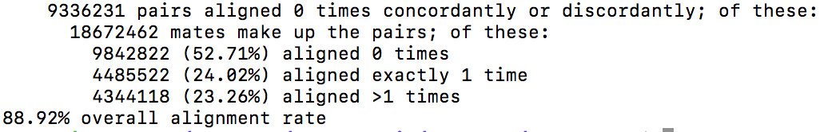
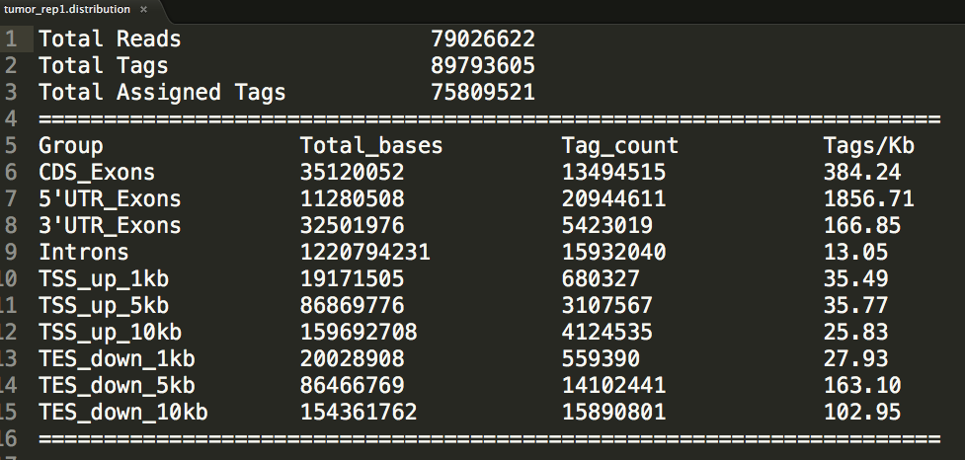
Mapping QC
  Percentage of reads properly mapped or uniquely mapped
  ‘align_summary.txt’ generated after tophat and log file after hisat2
  Reads distribution by read_distribution in RNA-SeQC(http://rseqc.sourceforge.net/ )
  Command: read_distribution.py -i accepted_hits.bam -r ${refseq} > dirstribution.txt
Expection: not less than 60%, more higher is better(>80%)
Output:
Exon percentage = Exon Tags / Total Tags
Intron percentage = Introns Tag_count/Total Tages
Expection:
CDS percentage is more high such as >40% while Intron percentage is low, such as no more than 20%.

Slide 15
From reads to differential expression
Raw Sequence Data
FASTQ Files
QC by
FastQC
Reads Mapping
Unspliced Mapping
BWA, Bowtie
Spliced mapping
TopHat, Hisat
Mapped Reads
SAM/BAM Files
QC by
RNA-SeQC
Expression Quantification
Summarize read counts
FPKM/RPKM
Cufflinks, Stringtie
QC between
replicates
DE testing
DEseq, edgeR, etc
Cuffdiff, Ballgown
List of DE
Functional Interpretation
Function enrichment
Integrate with other data or Infer networks …
Biological Insights & hypothesis

Slide 16
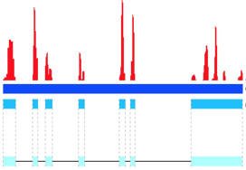
Expression quantification
Count data
RNAseq
tag density
htseq-count
  Command: htseq-count [options] alignment_file gff_file
  Parameters:
  -f SMAPLE: type of <alignment_file> data, either ‘sam’ or ‘bam’
  -r ORDER: sorting order of <alignment_file> by ‘name’ or ‘pos’
  -i IDATTR: GFF attribute to be used as feature ID.
  Example:
Chromosome
Known exons
htseq-count -f bam accepted_hits.bam -r pos -i transcript_id ${gtf} > ${sample}.count

Slide 17
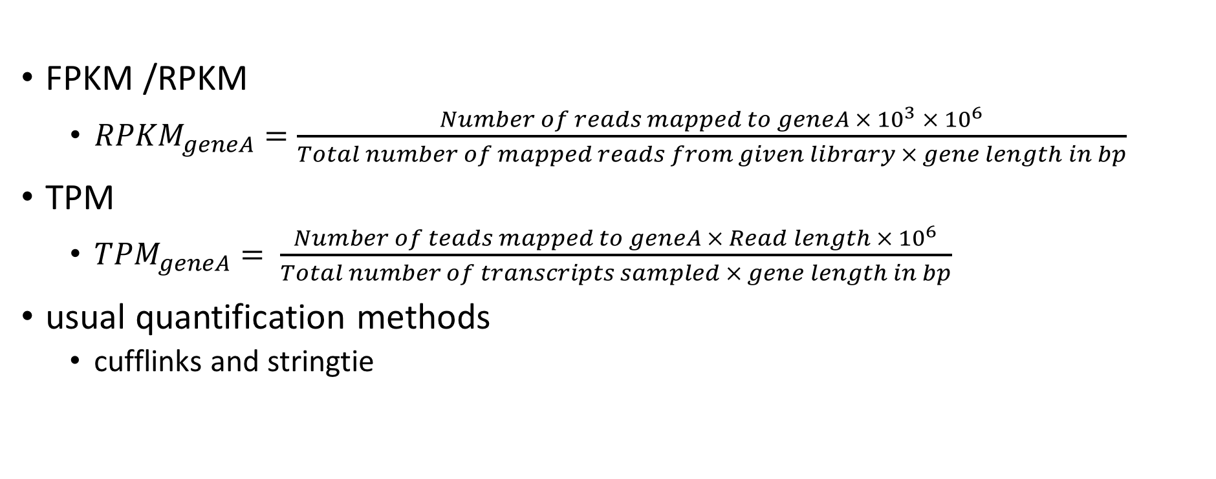
Expression quantification
The number of reads is roughly proportional to
  the length of the gene
  the total number of reads in the library
FPKM /RPKM
  ${RPKM}_{geneA}=\frac{Number of reads mapped to geneA × {10}^{3} ×{ 10}^{6}}{Total number of mapped reads from given library × gene length in bp}$
TPM
  ${TPM}_{geneA}= \frac{Number of teads mapped to geneA × Read length × {10}^{6}}{Total number of transcripts sampled × gene length in bp}$
usual quantification methods
  cufflinks and stringtie

Slide 18
Usual quantification methods
cufflinks
  Command:
    cufflinks [options] <hits.sam>
  Output:
    transcripts.gtf: transcriptome assembly
    isoforms.fpkm_tracking /genes.fpkm_tracking: transcript/gene level expression
stringtie
  Command:
    stringtie <aligned_reads.bam> [options]*
  Parameter:
    -A <gene_abund.tab> : gene abundances output file
    -B: enable the output of Ballgown input table files(*.ctab)
    -e: limit the processing to only the assembled transcripts matching the reference transcripts given with -G
  Output:
    data.gtf: GTF file containing the assembled transcripts
    gene_abund.tab: gene abundances (contains FPKM / TPM)
    Ballgown input table files: e2t.ctab, e_data.ctab, i2t.ctab, i_data.ctab, t_data.ctab
  Example
Example
    cufflinks -G hg19_refSeq.gtf -output-dir ./ accepted_hits.bam
    stringtie accepted_hits.bam -o ${sample}.gtf -p 8 -G ${gtf} -A gene_abund.tab -B -e

Slide 19
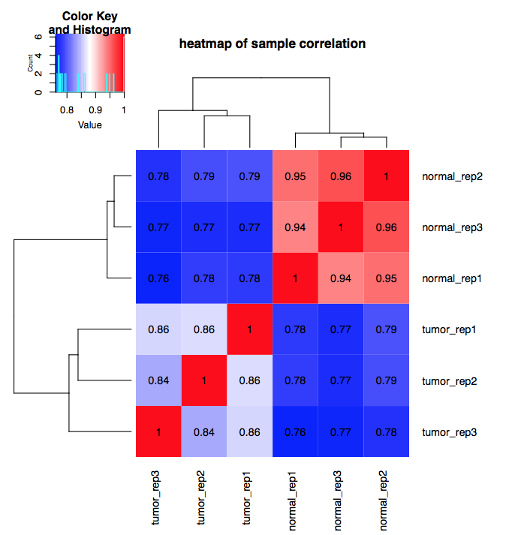
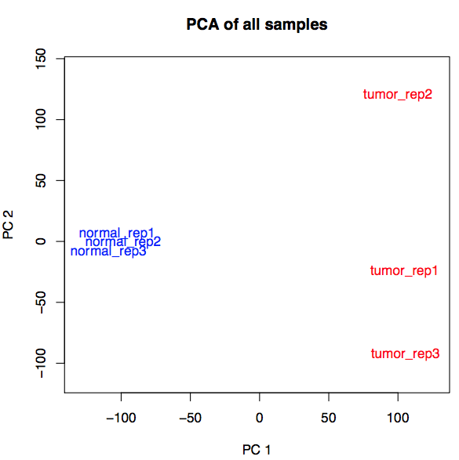
QC between replicates
Measure the quality of samples according to biological background:
heatmap of correlation
PCA(principal component analysis)

Slide 20
From reads to differential expression
Raw Sequence Data
FASTQ Files
QC by
FastQC
Reads Mapping
Unspliced Mapping
BWA, Bowtie
Spliced mapping
TopHat, Hisat
Mapped Reads
SAM/BAM Files
QC by
RNA-SeQC
Expression Quantification
Summarize read counts
FPKM/RPKM
Cufflinks, Stringtie
QC between
replicates
DE testing
DEseq, edgeR, etc
Cuffdiff, Ballgown
List of DE
Functional Interpretation
Function enrichment
Integrate with other data or Infer networks …
Biological Insights & hypothesis

Slide 21
GFOLD
GFOLD is based on the posterior distribution of log fold change.
Command:
Output:
  main output file contains GFOLD value, which can be considered as a reliable log2 fold change.
  get DEGs according to ‘GFOLD’ [fold change = 2]:
    if GFOLD > 1, upregulated
    if GFOLD < -1, downregulated
GFOLD is especially useful when no replicate is available.
    samtools view ${sample}.bam | gfold count -ann ${gtf} -tag stdin -o ${sample}.read_cnt #count reads
    gfold diff -s1 sample1, sample2 -s2 sample3 -suf .read_cnt -o 12vs3.diff #DEGs

Slide 22
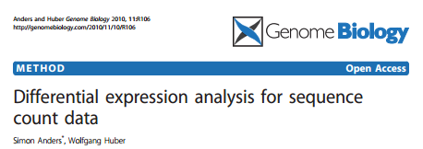
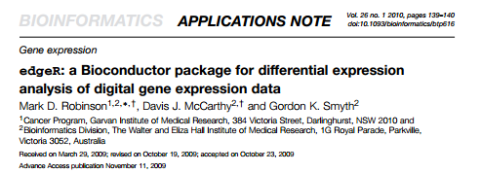
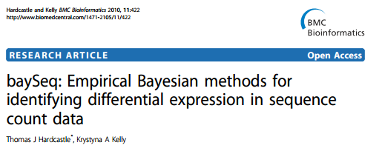
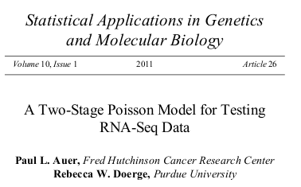
Count-based methods (R packages)
edgeR -- use an overdispersed Poisson model
DESeq -- based on negative binomial distribution
baySeq -- use an empirical Bayes approach

Slide 23
RPKM/FPKM-based methods
Cuffdiff
  Command:
  Output:
  isoform_exp.diff, gene_exp.diff, tss_group_exp.diff, cds_exp.diff
  #significant changes for spliced transcripts, primary transcripts, genes and coding sequences.
ballgown (R packages)
  based on basic linear modeling strategy
    cuffdiff [options] <transcripts.gtf> <sample1_hits.sam> <sample2_hits.sam> [… sampleN_hits.sam]
Notes:
http://cole-trapnell-lab.github.io/cufflinks/cuffdiff/

Slide 24
From reads to differential expression
Raw Sequence Data
FASTQ Files
QC by
FastQC
Reads Mapping
Unspliced Mapping
BWA, Bowtie
Spliced mapping
TopHat, Hisat
Mapped Reads
SAM/BAM Files
QC by
RNA-SeQC
Expression Quantification
Summarize read counts
FPKM/RPKM
Cufflinks, Stringtie
QC between
replicates
DE testing
DEseq, edgeR, etc
Cuffdiff, Ballgown
List of DE
Functional Interpretation
Function enrichment
Integrate with other data or Infer networks …
Biological Insights & hypothesis

Slide 25
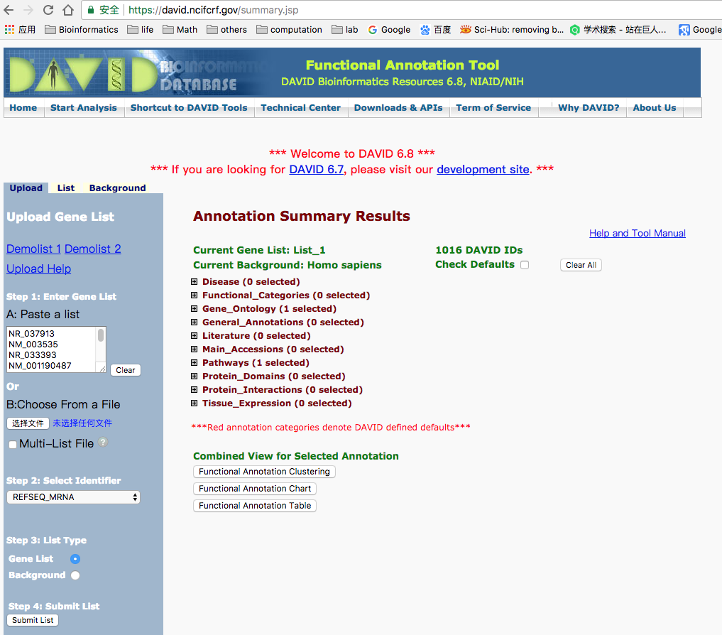
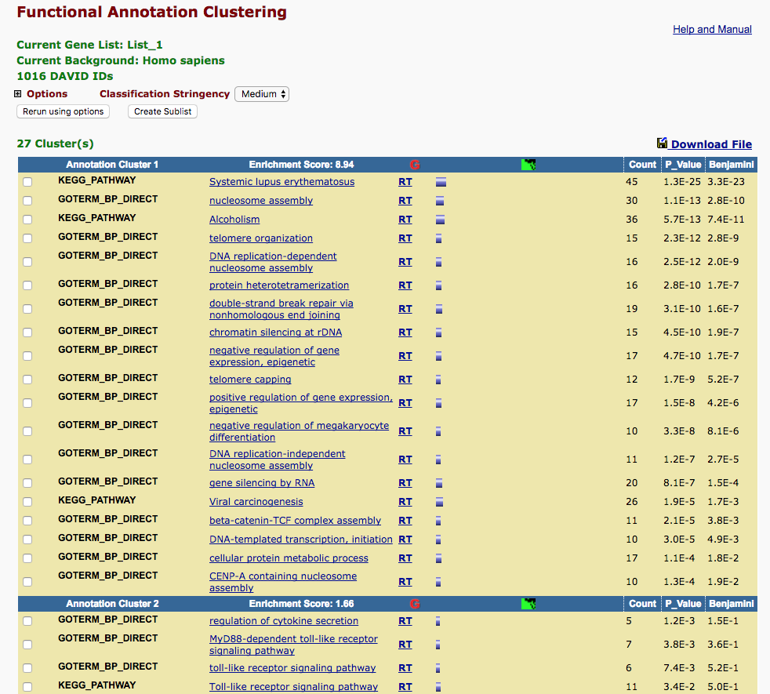
Functional Interpretation
Functional enrichment of DEGs using DAVID(https://david.ncifcrf.gov/summary.jsp )

